Slide 1
Code Delivery, Co-Development, and the Year of Open Science @NASA
Ian Carroll (GSFC, UMBC)
Susanne Craig (GSFC, UMBC)

Slide 2
Outline
Code Delivery
preparing contributions
what to include?
about software licenses, what you need to know
worked-example (part 1)
bundling for delivery
what is a code repository?
about git and working with versions and branches
worked-example (part 2)
Co-Development
2023 is the “Year of Open Science”

Slide 3
Outline
Code Delivery
Co-Development
sharing a git repository
how is sharing code unlike sharing on Box, Google Drive, or Office 365?
about git remotes and cloud hosting
worked-example (part 3)
collaboration on implementation
PACE Science and Science Data Segment implement the algorithm
about upstream remotes
worked-example (part 4)
2023 is the “Year of Open Science”

Slide 4
Outline
Code Delivery
Co-Development
2023 is the “Year of Open Science”
What is open science?
Why open science?

Slide 5
Glossary
code and configuration = structured text for building software
repository = a file tree with data on the history of modifications
commit = repository data equivalent to a snapshot of its file tree
branch = one sequence of commits in a repository
remote = a separate instance of the same repository
data = input to, or output from, an executable

Slide 6
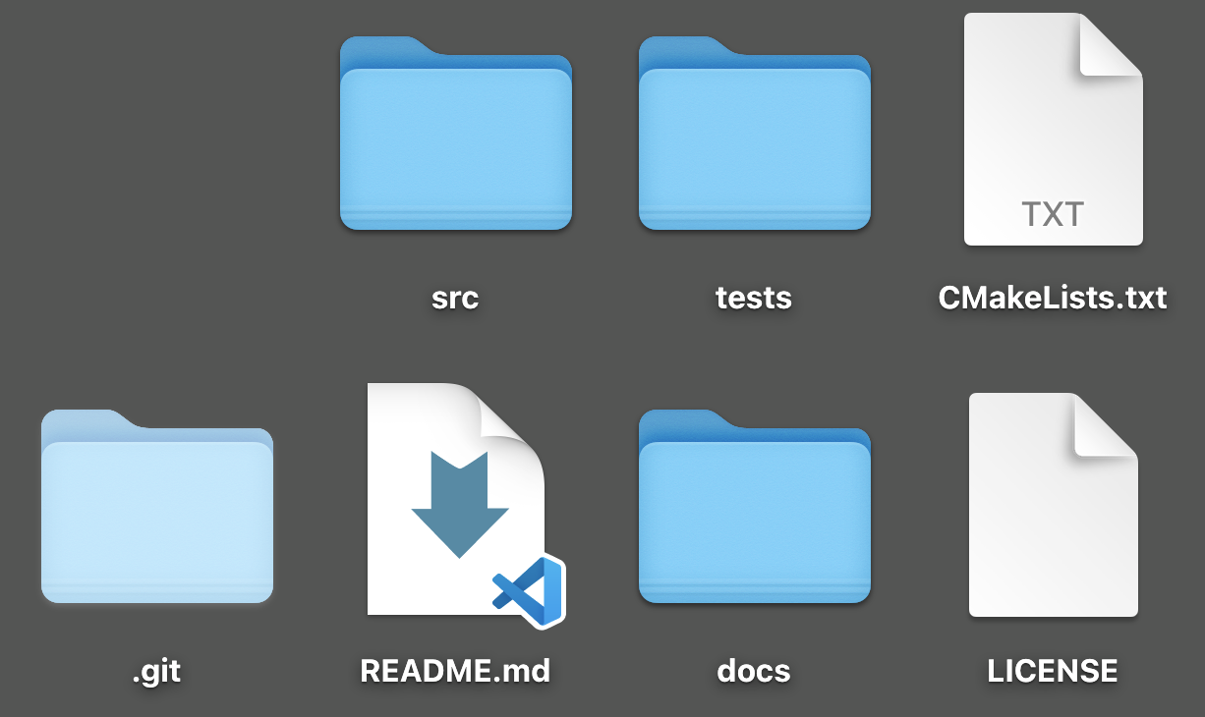
Preparing Contributions
Notes:
code
documentation x2 (actually x3)
license
tests
build configuration
[no data folder]
number one request from SDS can be boiled down to readability (translates to maintainability): documentation, conformity, modularity

Slide 7
1
2
confirm
consent of
copyright holder
choose a
license
3
4
identify
copyright
holder in the repo
make the
repo easy
to cite
Notes:
all PACE science data processing code is open source
granting us permissive license to use, or putting your code in the public domain, right away facilitates that process
how to open source
include a “LICENSE” file in the repository
identify the copyright holder on each code file, if necessary
indicate license in build configuration, if necessary
determine whether the copyright holder needs to be notified, e.g. a University’s “Office of Technology Development” (or similar), prior to first publication
trust your judgement

Slide 8
$ tree -L 1
.
├── CITATION.cff
├── LICENSE
├── README.md
├── docs
├── nniop
├── pyproject.toml
└── tests
how to cite
software license or public domain statement
documentation for users and for developers
source code (language specific convention)
build requirements (e.g. compile, test, package)
tests

Slide 9
$ head LICENSE
Apache License
Version 2.0, January 2004
http://www.apache.org/licenses/
TERMS AND CONDITIONS FOR USE, REPRODUCTION, AND DISTRIBUTION
1. Definitions.
"License" shall mean the terms and conditions for use, reproduction,
$ head nniop/__init__.py
# Copyright [yyyy] [name of copyright owner]
#
# Licensed under the Apache License, Version 2.0 (the "License");
# you may not use this file except in compliance with the License.
$ grep 'license' pyproject.toml
license = "Apache-2.0"
full text of a permissive license
identification of copyright owner
name of license in build configuration

Slide 10
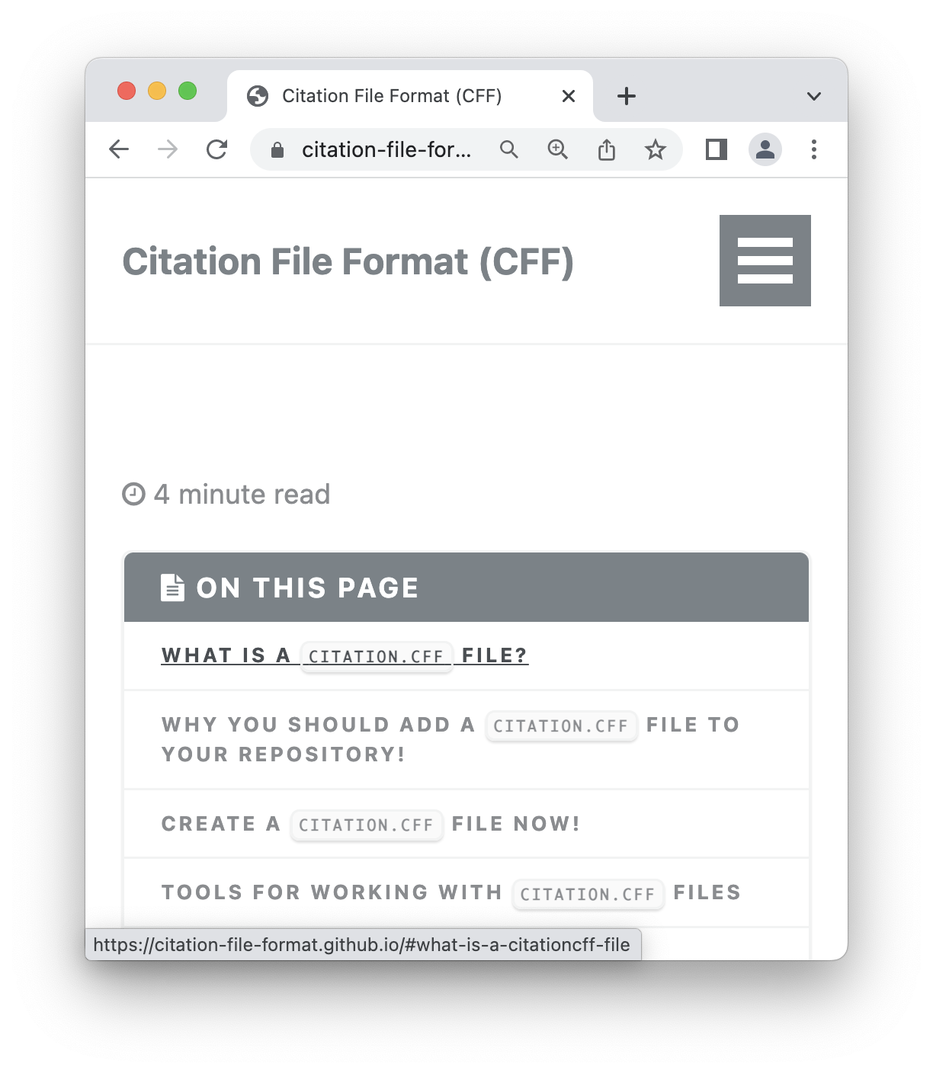
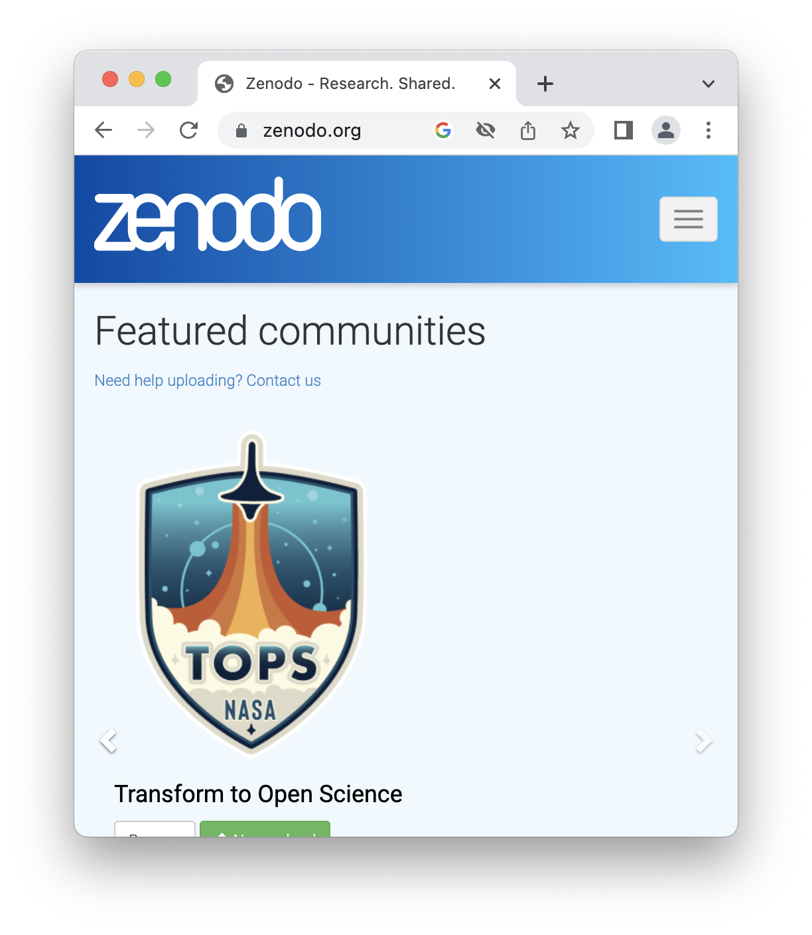
Notes:
open source does not mean open season
add a CITATION.cff file to help users know how to give you attribution
get a DOI from zenodo.com

Slide 11
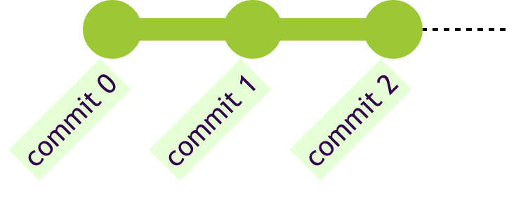
Bundling for Delivery
Notes:
a folder of files becomes a repository when it is accompanied by a history of file changes, allowing
recovery to, or inspection of, prior snapshots
traceability and accountability
controlled synchronization (semi-automatic merging of diverging histories)
a user (v.) commits a set of changes in one or more files to a repository. we also call the associated version a (n.) commit
the history is composed only of commits; not every File > Save operation, or keystroke, is an event in the history
every commit is a “version” of all the files in the repository, so do not include version information in file names

Slide 12
Notes:
git is a popular, free, and open source, tool for writing repositories
git adds to your folder all the data (hidden in the “.git” subfolder) about commits in the repository

Slide 13
$ tree -a -L 1
.
├── .git
├── CITATION.cff
├── LICENSE
├── README.md
├── docs
├── nniop
├── pyproject.toml
└── tests
$ git log --oneline
30ba4d0 (HEAD -> main) add Apache license
8ed0b99 configure setuptools
3132df8 initial commit
data on changes anywhere within the file tree
git command to print summary of previous versions

Slide 14
Notes:
some commits are assigned friendly names, knows as tags
a git branch is where you append new commits (TMI: a branch is a movable pointer to a commit)
its possible for that 5th commit to be made on main between commits on dev because the state of the file system, what you see and work on, can be popped out of the hidden folder at any time
the 7th commit here is a merge, this requires manual supervision that “main” and “dev” don’t conflict in some way

Slide 15
$ git checkout 3132df8
HEAD is now at 3132df8 initial commit
$ tree -a -L 1
.
├── .git
├── README.md
├── docs
├── pace_algo
└── tests
$ git checkout main
Previous HEAD position was 3132df8 initial commit
Switched to branch 'main’
$ git log --oneline
30ba4d0 (HEAD -> main) add Apache license
8ed0b99 configure setuptools
3132df8 initial commit

Slide 16
Sharing a git Repository
Bitbucket
Notes:
above all else, a repository facilitates collaboration because anyone’s commit can be integrated into anyone else’s log
hosting a git repository means maintaing a copy of its data that all collaborators can access, but not any old bucket, box, or drive will do
several companies freely offer a hosting service for git repositories (github.com, gitlab.com, and bitbucket.com), and add features, like “issues” and “forking”, that are not part of git
some institutions provide a git hosting service for their communities, often using GitLab, the same software behind gitlab.com

Slide 17
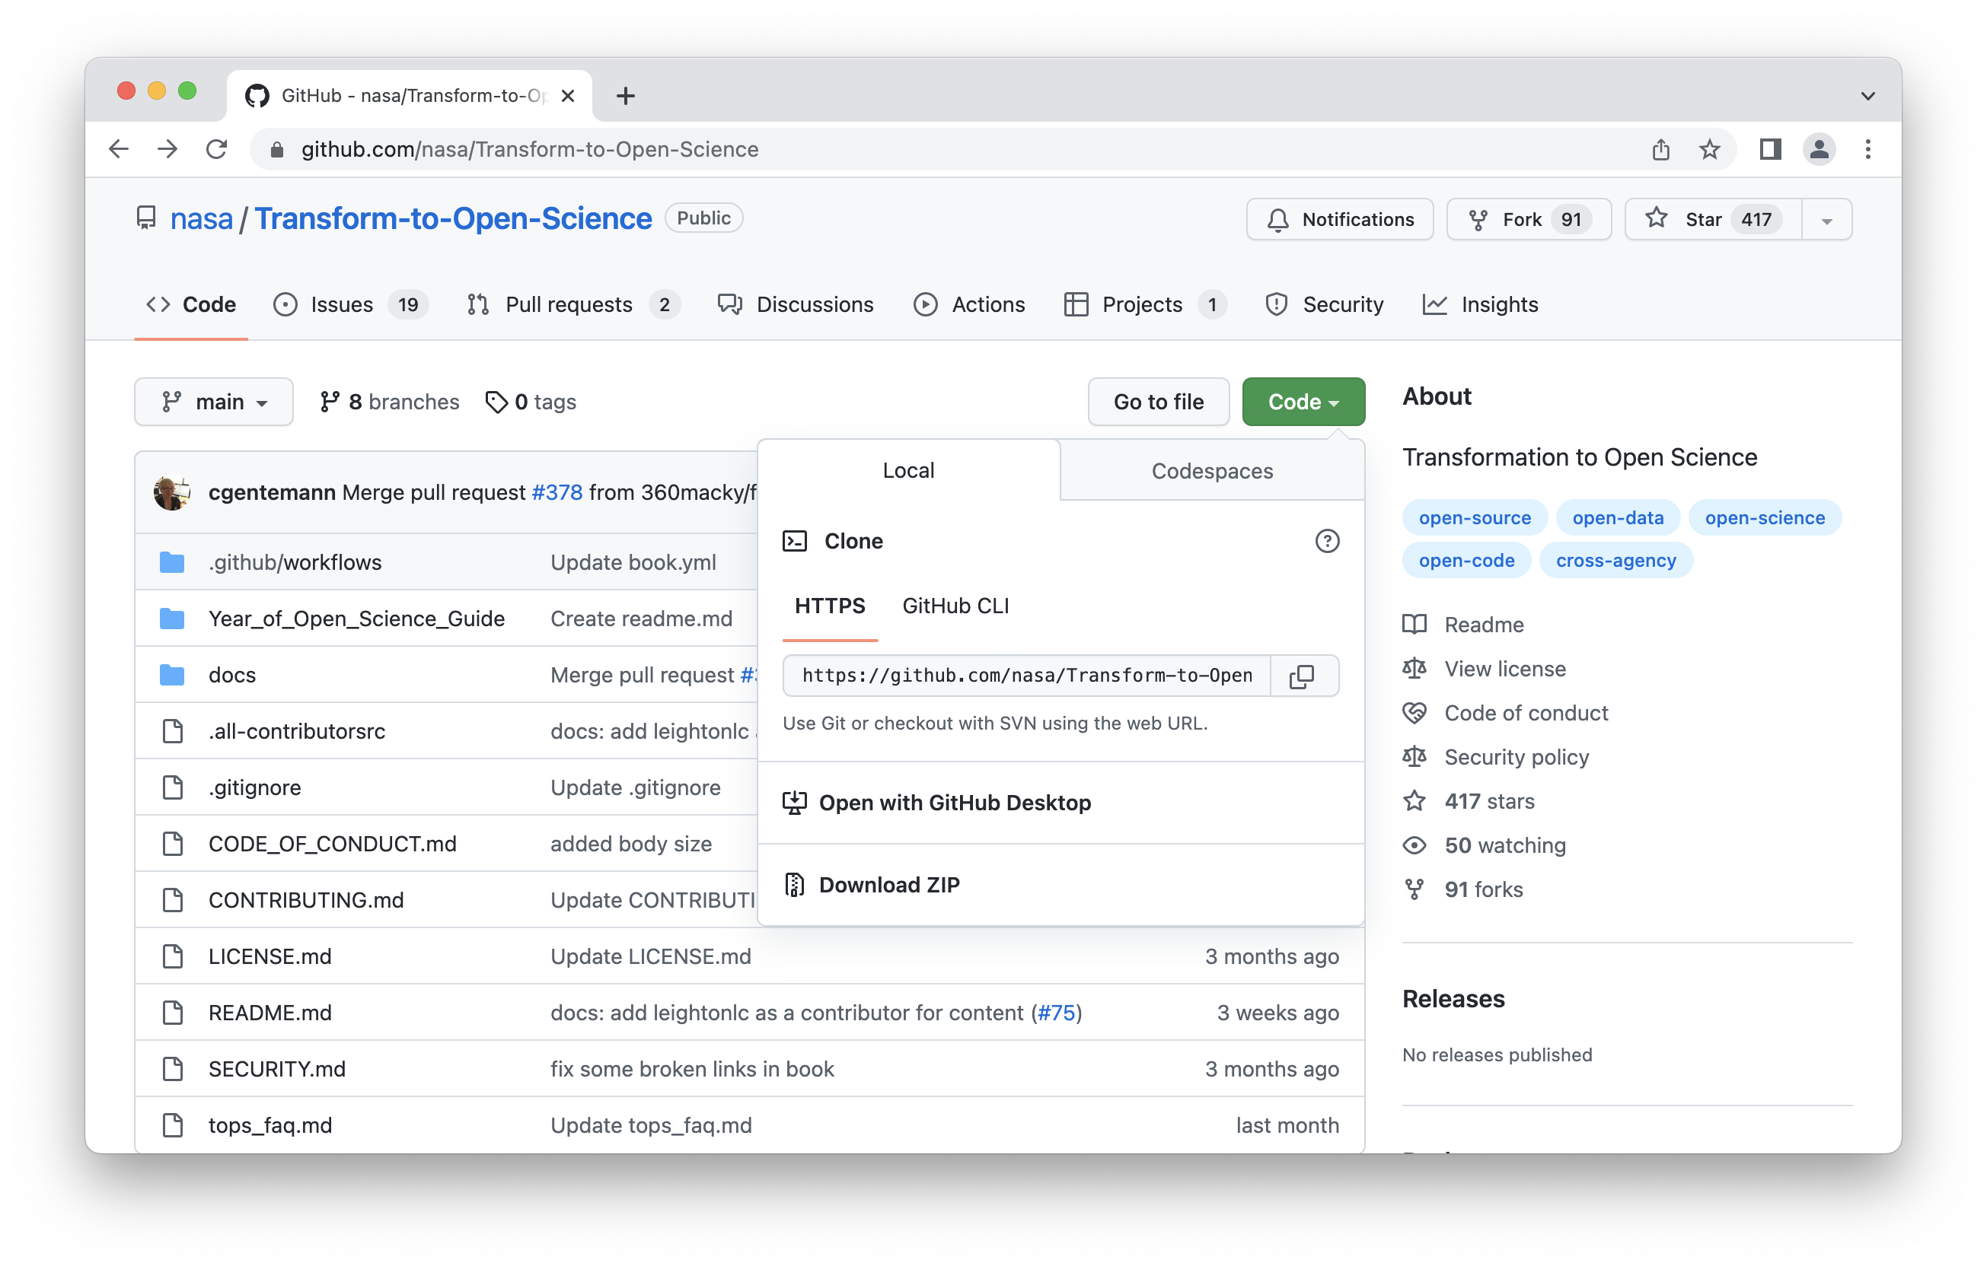
Notes:
a new repository just has the “main” branch, and that could be almost all you need
a git remote is a separate copy of a repository that git can communicate with over HTTPS or SSH to synchronize changes
git will keep a copy of the remote “main” branch in your local repository

Slide 18
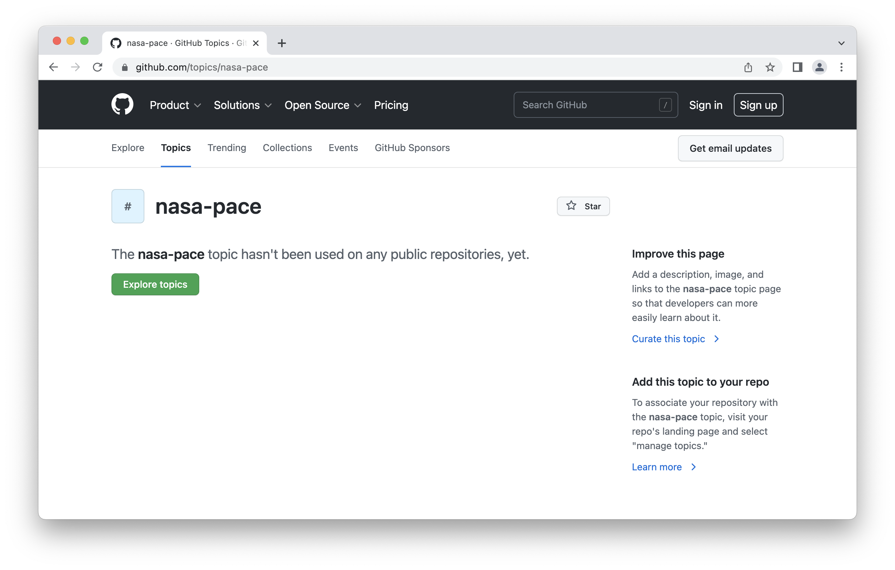
open the repository at the first commit in the log
$ git checkout 3132df8
HEAD is now at 3132df8 initial commit
$ tree -a -L 1
.
├── .git
├── README.md
├── docs
├── nniop
└── tests
5 directories, 1 file
$ git checkout main
Previous HEAD position was 3132df8 initial commit
Switched to branch 'main'
$ git branch -v
* main 30ba4d0 add Apache license
$
open at the branch called “main”
#nasa-pace

Slide 19
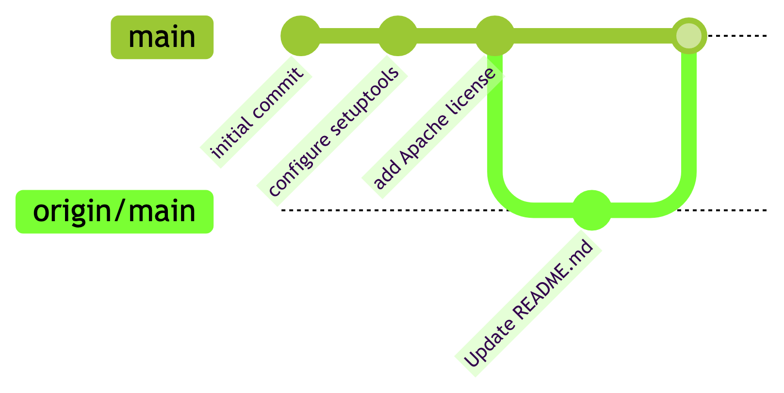

Slide 20
$ git branch -avv
* main 30ba4d0 [origin/main] add Apache license
remotes/origin/main 30ba4d0 add Apache license
$ git log --oneline
30ba4d0 (HEAD -> main, origin/main) add Apache license
8ed0b99 configure setuptools
3132df8 initial commit
$ git fetch
$ git branch -avv
* main 30ba4d0 [origin/main: behind 1] add Apache license
remotes/origin/main 903f9fe Update README.md
$ git merge origin/main
Updating 30ba4d0..903f9fe
Fast-forward
README.md | 1 +
1 file changed, 1 insertion(+)
latest commits on all (local and remote) branches
the local and remote branches are synchronized
update the local branch from the remote branch
update remote branches from the origin repository

Slide 21
$ git reset --hard 30ba4d0
HEAD is now at 30ba4d0 add Apache license
$ git log --oneline
30ba4d0 (HEAD -> main) add Apache license
8ed0b99 configure setuptools
3132df8 initial commit
$ git pull
Updating 30ba4d0..903f9fe
Fast-forward
README.md | 1 +
1 file changed, 1 insertion(+)
$ git log --oneline
903f9fe (HEAD -> main, origin/main) Update README.md
30ba4d0 add Apache license
8ed0b99 configure setuptools
3132df8 initial commit
rewind
fetch and merge at the same time
local and remote branches now synchronized

Slide 22
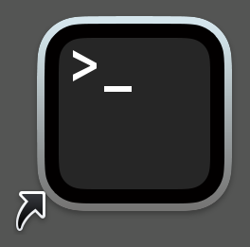
Notes:
- the cloud host is a mechanism for allowing multiple developers to work on the same clone

Slide 23
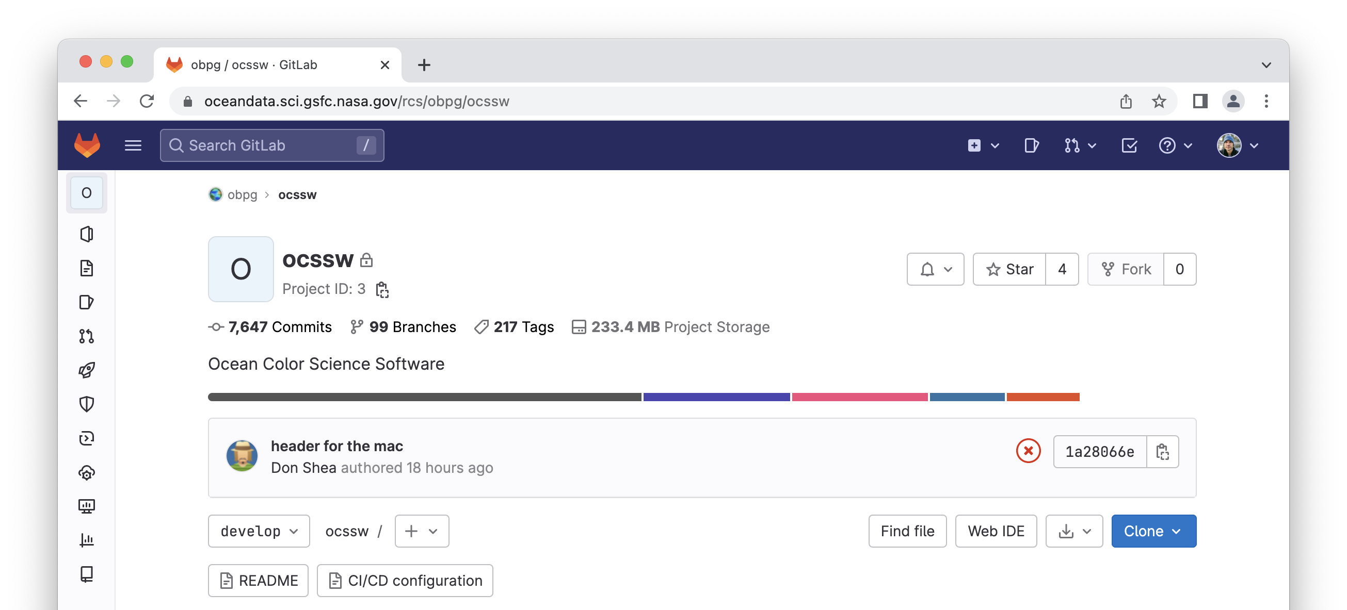
Collaboration on Implementation
Notes:
what does SDS have to do with your code to make it work
much of the time, re-write it in C++ and take advantage of tools already existing within ocssw
ocssw is a “monorepo”, meaning individual algorithms are not separate repositories.
customize input and output paths (probably modify code)
augment tests for internal systems (probably modify code)
you will see what SDS does on oceandata.sci.gsfc.nasa.gov/rcs
but we cannot grant you write access,
and we cannot accept write access to your preferred remote,
but using git we can still synchronize repositories
don’t promise to always create a repo, algorithims will often be re-written in the “monorepo”. how can we maintain a link to contributor? discussion topic?
it may be that algorithm repositories should include ocssw as a submodule

Slide 24
Notes:
- federated pull requests do not exist

Slide 25
Notes:
- in addition to the “origin” remote, you may configure an “upstream” remote to merge commits made by the SDS

Slide 26
$ git remote
origin
upstream
$ git fetch upstream
$ git branch -avv
* main 903f9fe [origin/main] Update README.md
remotes/origin/main 903f9fe Update README.md
remotes/upstream/main fbd757b introduce OCSSWROOT
$ git merge upstream/main
Updating 903f9fe..fbd757b
Fast-forward
nniop/__init__.py | 4 ++++
1 file changed, 4 insertions(+)
a second remote
upstream/main branch
is not synchronized
merge the remote branch to the local branch

Slide 27
$ git log --oneline
fbd757b (HEAD -> main, upstream/main) introduce OCSSWROOT
903f9fe (origin/main) Update README.md
30ba4d0 add Apache license
8ed0b99 configure setuptools
3132df8 initial commit
$ git push
$ git log --oneline
fbd757b (HEAD -> main, origin/main, upstream/main) introduce OCSSWROOT
903f9fe Update README.md
30ba4d0 add Apache license
8ed0b99 configure setuptools
3132df8 initial commit
main and origin/main are not synchronized…
… until you push commits to the origin

Slide 28
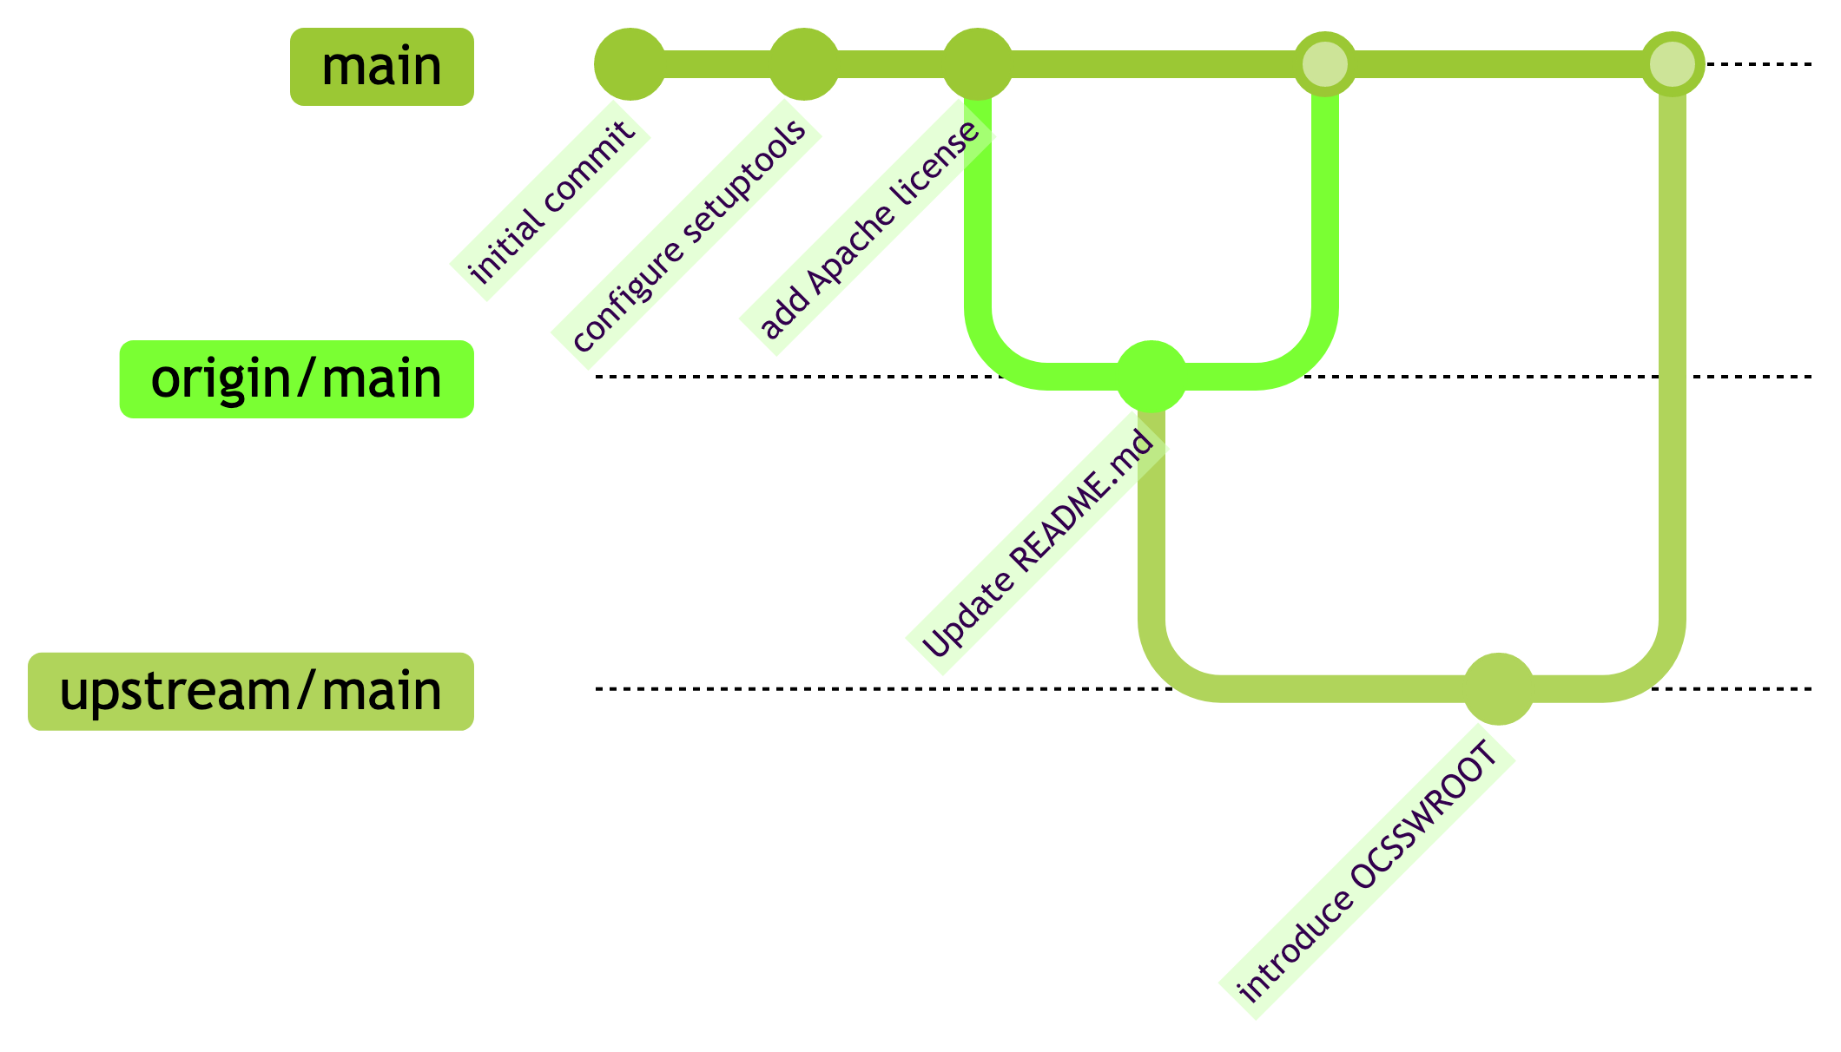

Slide 29
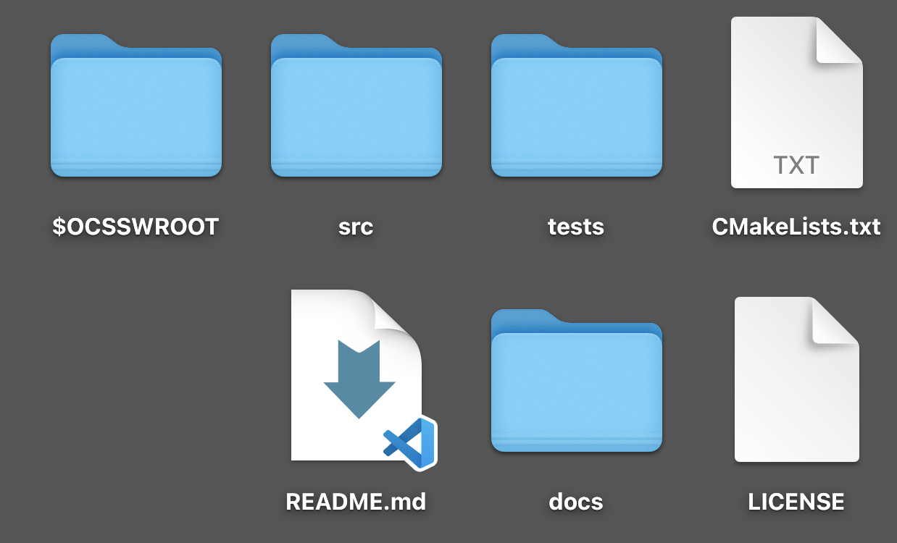
Notes:
your code repository should be as small as possible, so do not include data in your repository
definitely no data needed for implementation, maybe for testing, but generally you shouldn’t keep data in a repository with your code
getting existing data out of a repository takes more work than deleting it in a new commit, you have to clean up prior commits too, please do it right
any data will be distributed via SeaDAS, so start by putting it there and using a path relative to the “OCSSWROOT” environment variable

Slide 30
use your SeaDAS environment variable
$ tree -L 1 $OCSSWROOT/share
~/Applications/SeaDAS/ocssw
├── avhrr
├── common
├── oci
├── ocrvc
└── viirs
$ python -q
>>> from nniop import DATAROOT
>>> print(DATAROOT)
~/Applications/SeaDAS/ocssw/share/oci/nniop
$ cd $OCSSWROOT/share/oci
$ install_ocssw --tag=V2022.3 --create_change
installedTag = V2022.3
oci (T2022.15..V2022.3)
New Files:
share/oci/nniop/nniop-luts.nc
Creating V2022.3_2023-02-14_<username>.tar
build $OCSSWROOT into your DATAROOT,
and assume the path will change
create an archive from the parent directory
email this archive as needed

Slide 31
Glossary
code and configuration = structured text for building software
repository = a file tree with data on the history of modifications
commit = repository data equivalent to a snapshot of its file tree
branch = one sequence of commits in a repository
remote = a separate instance of the same repository
data = input to, or output from, an executable

Slide 32
1
2
confirm
consent of
copyright holder
choose a
license
3
4
identify
copyright
holder in the repo
make the
repo easy
to cite
Notes:
all PACE science data processing code is open source
granting us permissive license to use, or putting your code in the public domain, right away facilitates that process
how to open source
include a “LICENSE” file in the repository
identify the copyright holder on each code file, if necessary
indicate license in build configuration, if necessary
determine whether the copyright holder needs to be notified, e.g. a University’s “Office of Technology Development” (or similar), prior to first publication
trust your judgement

Slide 33
2023 – Year of Open Science
NASA Transform to Open Science (TOPS)
https://nasa.github.io/Transform-to-Open-Science/

Slide 34
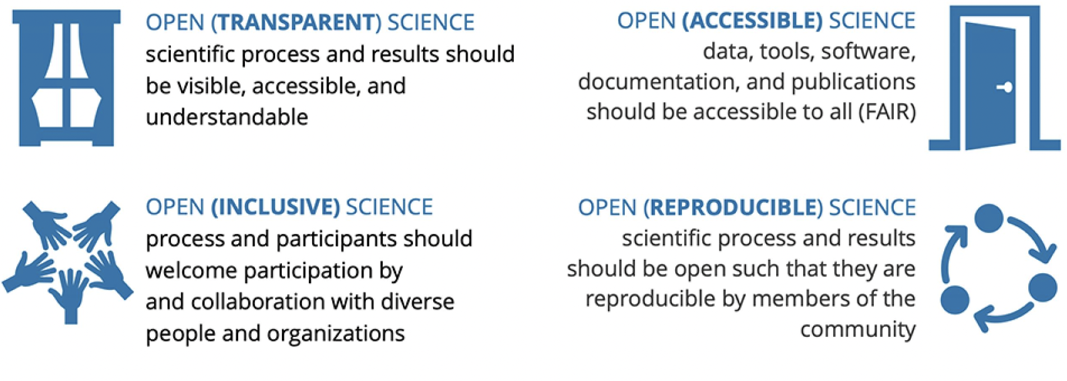
What is Open Science?
The principles of open-source science are to make publicly funded scientific research transparent, inclusive, accessible, and reproducible
Open-source science is a commitment to the open sharing of software, data, and knowledge as early as possible in the scientific process:
Algorithms, papers, documents, ancillary information,…
NASA has a long-term commitment to build an open science community over the next decade
Advances in technology alone is insufficient
Open-source science requires a culture shift to a more inclusive, transparent, and collaborative scientific process, which will increase the pace and quality of scientific progress
https://science.nasa.gov/open-science-overview

Slide 35
Why Open Science?
Accessibility
Citizen science initiatives and engagement
Lifesaving access to medical and scientific information
Democratization of the scientific process
Increased Earth observation accessibility
Efficiency & Innovation
Cleaner, more secure code with more contributors
More long-term maintenance assistance from the community
New monetized offices and data centers
Financially sound, streamlined, and transparent research spending
Reproducibility
Increased transparency of results from research
More reliable results with confirmation of previous findings
Less pressure to create ‘exciting’ research in order to be published
More robust products of the scientific method
Diversity & Inclusion
International accessibility
Breakdown of some systemic financial and funding barriers
Diversity among researchers and scientists
Equitable distribution of opportunity
https://science.nasa.gov/open-science/why-do-open-science

