Slide 1
What’s in a phytoplankton pigment? Integrating DNA sequencing and pigment observations to find out
Dylan Catlett
dylan.catlett@whoi.edu
Siegel PACE Team
Contributions from: Dave Siegel, Debora Iglesias-Rodriguez, Paul Matson, Emma Wear, Craig Carlson, Tom Lankiewicz, Kevin Son, Connie Liang, Lizzy Wilbanks
*NASA Ocean Color Image Gallery

Slide 2
Ocean color pigments
Phytoplankton absorption
Remote sensing reflectance
1 piece of Rrs
*Toole & Siegel, 2001, JGR; Bricaud et al., 2004, JGR Oceans

Slide 3
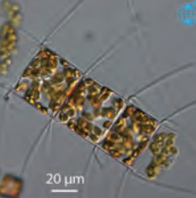
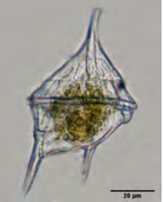
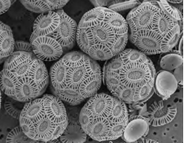
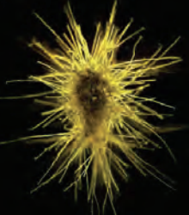
Phytoplankton pigments and composition
HPLC measures concentrations of ~25 phytoplankton pigments
Some pigments are “biomarkers” for particular groups of phytoplankton
Biomarker pigment:
Fuco
Perid
Hexfuco
MVChlb
Zea
Phytoplankton group:
(diatoms)
(prymnesiophytes)
(cyanobacteria)
(dinoflagellates)
(chlorophytes)
*Bricaud et al., 2004, JGR Oceans; IOCCG, 2014; Moreau, JGI

Slide 4
The assumption: biomarker pigment concentration changes reflect changes in PCC
Pigment concentrations
𝜇g L⁻¹
= diatom biomarker (Fuco)
= chlorophyte biomarker (MVChlb)
= dinoflagellate biomarker (Perid)
𝜇g L⁻¹
Notes:
Animate.

Slide 5
Problem 1: Phytoplankton physiological responses to environmental changes
Pigment concentrations
𝜇g L⁻¹
= diatom biomarker (Fuco)
= chlorophyte biomarker (MVChlb)
More light*
= dinoflagellate biomarker (Perid)
*Other stimuli that impact pigment expression include nutrient availability, temperature, others.
Responses to specific stimuli vary across species and groups
𝜇g L⁻¹
Notes:
Animate.

Slide 6
Problem 2: Many biomarker pigments lack specificity to a single phytoplankton group
To get at phytoplankton community composition from PACE, we need to understand and predict when and where these “pigment problems” arise.
Pigment concentrations
𝜇g L⁻¹
= diatom biomarker (Fuco)
= chlorophyte biomarker (MVChlb)
= dinoflagellate biomarker (Perid)
Not a diatom*
𝜇g L⁻¹
*Other sources of inter- and intra-group variability in biomarker pigment expression are known
Notes:
Animate.

Slide 7

HPLC is one of many approaches to quantify PCC
High throughput/
Low effort
Ocean color remote sensing
Automated imaging approaches
HPLC pigments/DNA meta-barcoding/other ‘omics
Flow cytometry
Epifluorescence microscopy
Traditional optical microscopy
Low throughput/
High effort
1 µm
10 µm
100 µm
1 mm
Observable cell sizes
*based on/adapted from Lombard et al., 2019, Frontiers Mar. Sci.

Slide 8
DNA meta-barcoding
3. PCR-amplify barcode genes
5a. Sequence Composition
1. Filter seawater
2. Extract DNA
4. Sequence
ATGC
ATGC
AAAT
GCGC
5b. Taxonomy Predictions
DNA meta-barcoding “measures” the relative sequence abundances of amplicon sequence variants (ASVs ≈ species)
Compare ASVs to reference seqs with known origin to assign taxonomy, get relative abundances of species/groups
Reference
??
ATGC =
GCGC =

Slide 9
I Plumes and Blooms
~3.5 years of concurrent DNA meta-barcoding and HPLC pigment obs. Detected ~2000 eukaryotic phytoplankton 18S-V9 ASVs (≈ species) in 215 surface samples.
*Catlett et al., 2021, Prog. in Oceanography; Catlett et al. in revision, L&O

Slide 10
Integrating DNA meta-barcoding and HPLC pigment observations to assess PCC
ATGC
ATGC
AAAT
GCGC
DNA
meta-barcoding
𝜇g L⁻¹
HPLC pigments

Slide 11
Integrating DNA meta-barcoding and HPLC pigment observations to assess PCC
ATGC
ATGC
AAAT
GCGC
DNA
meta-barcoding
x POC* =
𝜇g L⁻¹
Concentrations
𝜇g L⁻¹
HPLC pigments
*Assumes 18S copies scale with protist biomass and protists control POC variability

Slide 12
Integrating DNA meta-barcoding and HPLC pigment observations to assess PCC
ATGC
ATGC
AAAT
GCGC
DNA
meta-barcoding
x POC =
𝜇g L⁻¹
Compositions
𝜇g L⁻¹
÷ TChla* =
HPLC pigments
*Other approaches available, this requires relatively few assumptions

Slide 13
Phytoplankton group comparisons
Concentrations
Compositions
Diatoms
DNA Meta-barcoding
(Phytoplanktonic)
Dinoflagellates
Pigments
*Catlett et al., in review at L&O

Slide 14
Phytoplankton group comparisons
Concentrations
Compositions
Diatoms
DNA Meta-barcoding
sum(POC) of 3 putative Fuco-containing Dinoflagellates
sum(Rel. Abun.) of 3 putative Fuco-containing Dinoflagellates
(Phytoplanktonic)
Dinoflagellates
Pigments
*Catlett et al., in review at L&O

Slide 15
This is a large source of uncertainty in pigment-based PCC estimates in the SB Channel
Pigment concentrations
𝜇g L⁻¹
= diatom biomarker (Fuco)
= chlorophyte biomarker (MVChlb)
= dinoflagellate biomarker (Perid)
Not a diatom*
𝜇g L⁻¹
*Other sources of inter- and intra-group variability in biomarker pigment expression are known
Notes:
Animate.

Slide 16
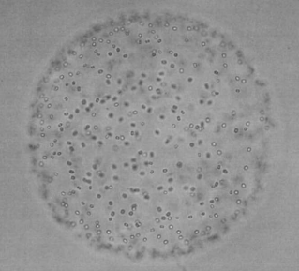
Disagreements provide new physiological insights
Phaeocystis globosa
Other Prymnesiophytes
P. globosa forms carbon-rich colonies and is known to occasionally express 0 Hexfuco!
*Baumann et al. 1994, J. Marine Systems; Schoemann et al. 2005, J. Sea Research; Catlett et al., in review at L&O

Slide 17
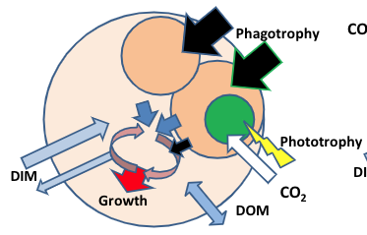
Mixotrophy marker pigments?
Teleaulax = cryptophyte phytoplankton
Mesodinium = ciliate, can be phago-heterotroph or mixotroph
Allo = Alloxanthin, marker pigment for cryptophyte phytoplankton
Covariation network shows significant correlations (green lines connecting two dots) between specific pigments (dots) and ASVs ≈ species (dots)
Alloxanthin is likely a marker pigment for mixotrophic ciliates in the SB Channel
*adapted from Mitra et al., 2016, Protist

Slide 18
Phytoplankton pigments covary with diverse phytoplankton groups
Diatom
Dino
Chlorophytes
Prymnesiophytes
Picophyto
*Catlett & Siegel, 2018, 2021; Catlett et al., in review at L&O

Slide 19
Phytoplankton pigments covary with diverse phytoplankton groups
“Pigment communities”
“Pigment + DNA barcode communities”
2 + 3
?
1
2
3
4
5
5
4
1
Diatom
Dino
Chlorophytes
Prymnesiophytes
Picophyto
*Catlett et al., in review at L&O

Slide 20
Take-aways for phytoplankton composition/groups from PACE
Integrating in situ phytoplankton composition methods provides new and improved interpretations and insights of remotely sensible pigment dynamics
Distinct suites of phytoplankton pigments covary with diverse assemblages of phytoplankton (and zoo- and mixo-plankton)
More work needed to develop predictive models to estimate phytoplankton composition from remotely sensible pigment concentrations (+ other remotely sensible parameters and properties)

Slide 21





Acknowledgements

Slide 22
Problem: what’s a phytoplankton?
With standard bioinformatic methods > 30% ASVs come from an unknown class, which makes it hard to ID phytoplankton
ensembleTax R package integrates taxonomic assignments from multiple algorithms/reference databases, allowing enhanced phytoplankton classification
Ensemble methods provide more broad ASV classifications
Algorithm 1, ref DB 1
Bacillariophyta
ATCG
Algorithm 1, ref DB 2
Diatomea
Algorithm 2, ref DB 1
Dinophyceae
Algorithm 1, ref DB 1
?????????
GCGT
Algorithm 1, ref DB 2
?????????
Algorithm 2, ref DB 1
Dinophyceae
*Thanks Kevin Son and Connie Liang!
*Catlett et al., 2021, PeerJ

Slide 23
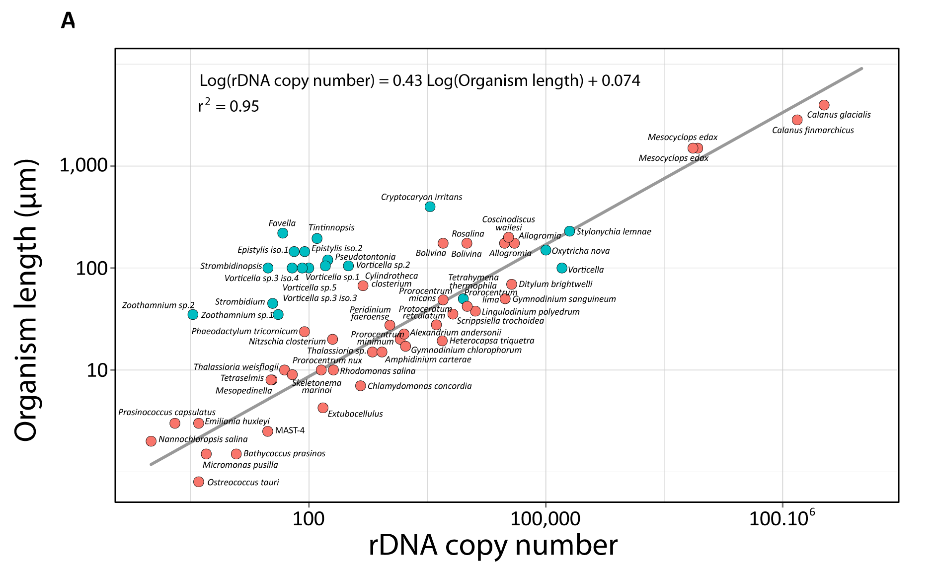
*De Vargas et al., 2015

Slide 25
Network with phyto ASVs

Slide 26
Pigments with non-phyto classes and ASVs

