Slide 1
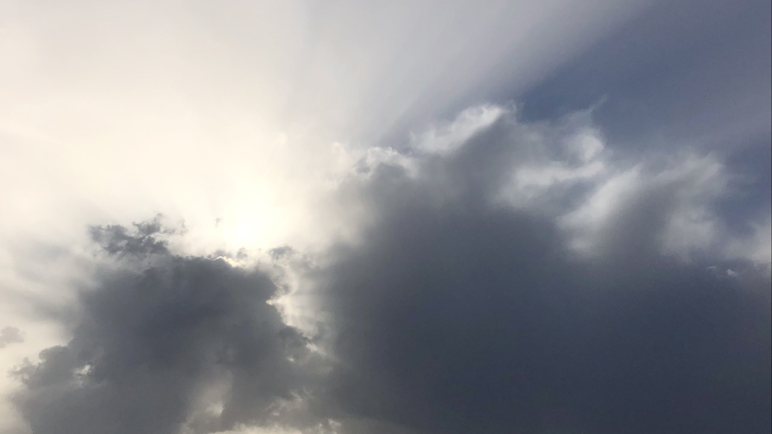
PACE SAT polarimetry group meeting
Kirk Knobelspiesse, July 27, 2021

Slide 2
Agenda
Project and instrument team updates
Making an algorithm? Start the data product selection process!
Described in Data Product Selection Plan: https://pace.oceansciences.org/docs/TM-20205007069-2020-219027-Vol.-8-PACE_vol8.pdf
First submit a “Science Product Change Request” then have a review by the Science Operations Team (SOT). They start the process of implementation and testing
Science Operations Board (SOB) approves when ready.
Also needs a Product and Algorithm Description Document (PADD, like ATBD, but living documents).
So far we have started the process for SRON/SPEXone aerosol algorithm (RemoTAP) and Project Science aerosol algorithm (fastMAPOL)
ACCP/AtmOS
https://vac.gsfc.nasa.gov/accp/
Pre-phase A mission to have two spacecraft, ~2028 (inclined orbit), 2029 (polar orbit)
Each will have a polarimeter, plus lidar, radar, microwave radiometers, and more
My new role: 50% PACE, 50% ACCP/AtmOS polarimeter instrument scientist

Slide 3
Agenda
19th Electromagnetic & Light Scattering Conference (ELS-XIX)
https://els2021.physics.itmo.ru/
Speakers included Jacek, Bastiaan, Meng, Pengwang
🔹 YouTube broadcast on Monday, 12 July; Jacek at 15:55 - 16:10
🔹 YouTube broadcast on Tuesday, 13 July
🔹 YouTube broadcast on Wednesday, 14 July
🔹 YouTube broadcast on Thursday, 15 July; Bastiaan at 19:00 - 19:15, Meng at 19:50 - 20:05, Pengwang at 20:20 - 20:35
🔹 YouTube broadcast on Friday, 16 July
The main event: team updates. 10 minutes each, please
Pengwang Zhai “Theoretical Support for Developing the PACE Atmospheric Correction Algorithm: Radiative Transfer and Polarimetric Retrieval of Aerosol Properties”
Matteo Ottaviani “Remote Sensing of the Ocean Surface Refractive Index and Oil Spill Detection for the PACE Mission”
Jacek Chowdhary “PACE UV Retrieval of Ocean and Atmosphere Data-Products (PACE UV ROAD): CDM, BrC and BC Polarimetry”
Next meeting August 16th: Stamnes, Twardowski, van Diedenhoven / Geogdzhayev, Xiaodong

