Slide 1
Ozone Absorption Cross Section Dataset
Brian Cairns and Peng-Wang Zhai
¹NASA GISS
²JCET/Physics Department, UMBC

Slide 2
A remembrance to our colleague: Michael Mishchenko.

Slide 3
Motivation
OCI covers 300-890 nm, for which an accurate ozone absorption spectra is needed in the UV.
The Serdyuchenko 2013 dataset covers 213 nm – 1100 nm, and a number of temperatures (193 K, 203 K, …, 293 K.)
The OMI team currently uses the BMD (Brion et al., 1993, 1998; Daumont et al., 1992; Malicet et al., 1995) coefficients which are from 250 nm – 500 nm, which will be used as a reference in this presentation.
Ideally we should use a newer dataset Serdyuchenko 2013 to obtain the general temperature dependence, which would be most flexible.

Slide 4
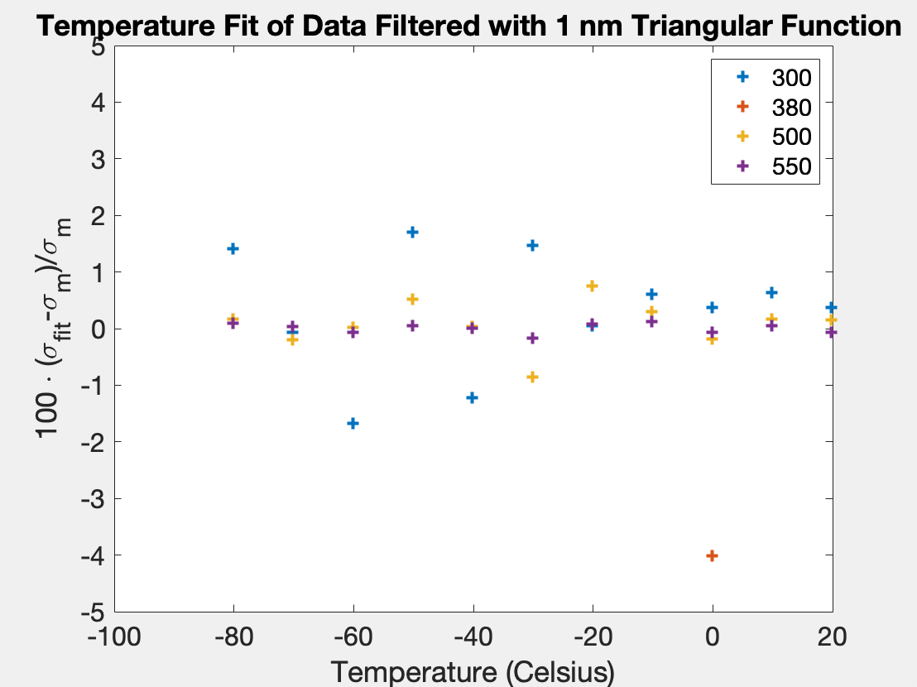
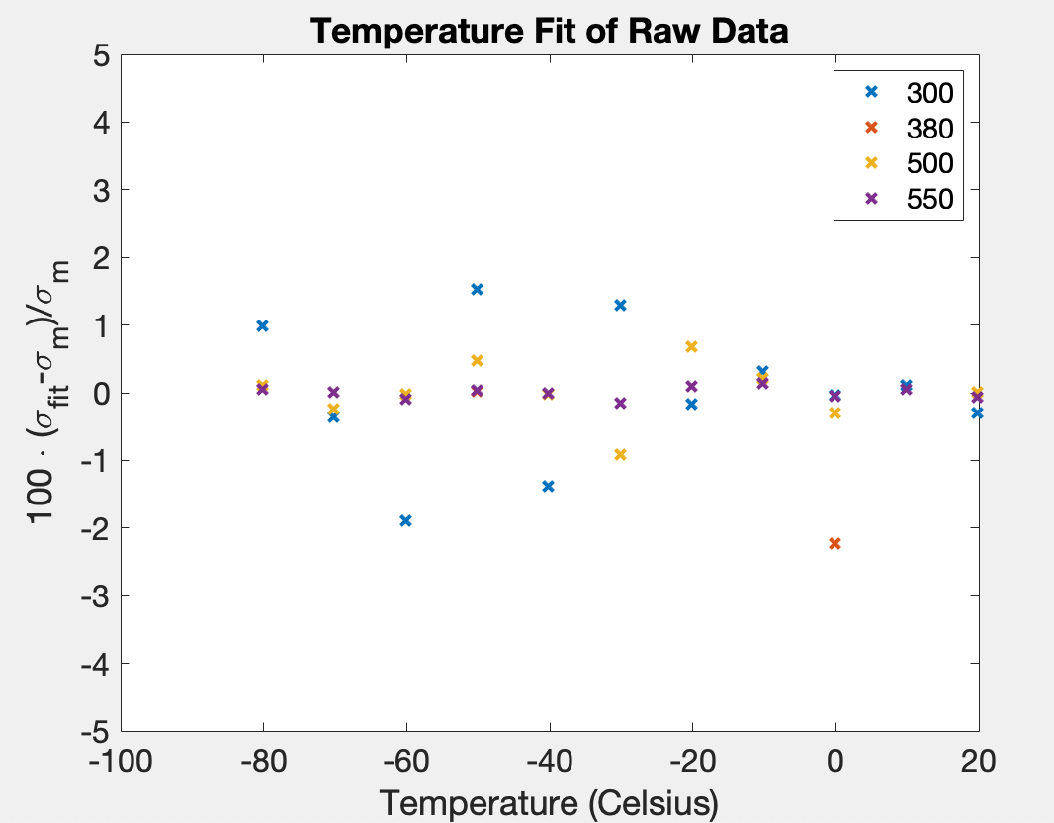
Validation of the fitting: $σ=C_{0}+C_{1}T+C_{2}T^{2}$
T is temperature in Celsius.

Slide 5
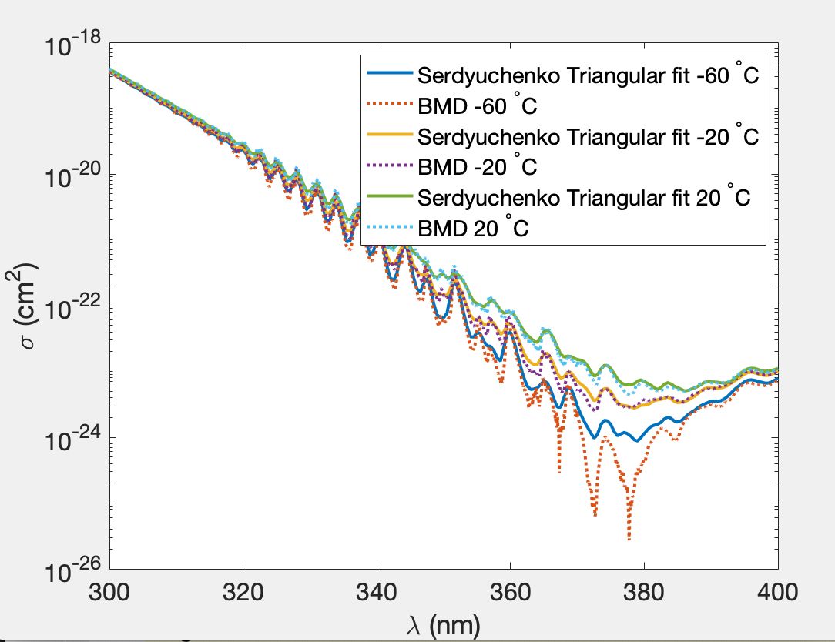
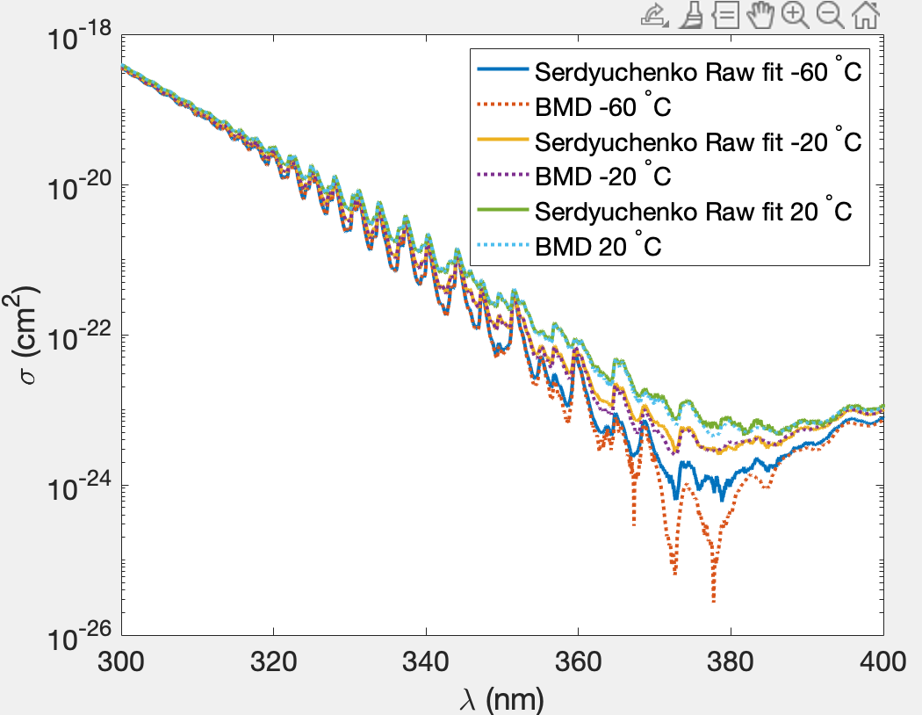
Spectra comparison

Slide 6
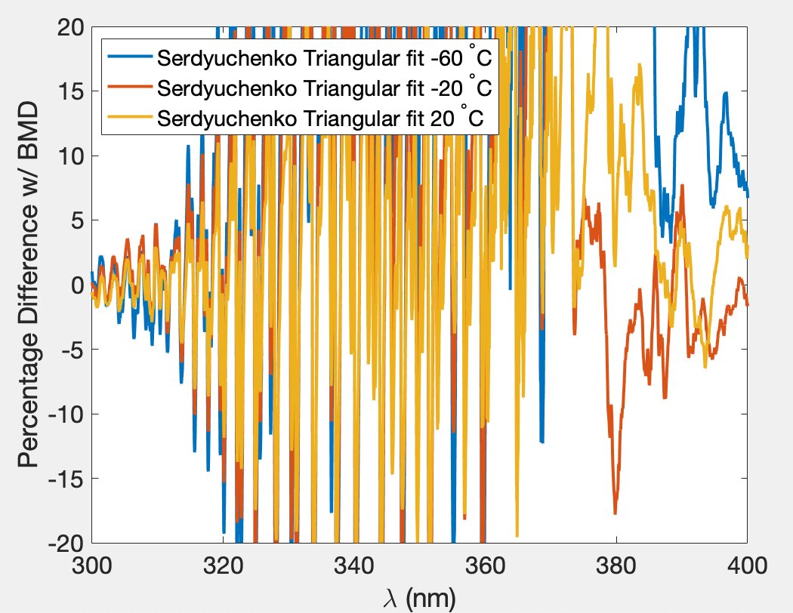
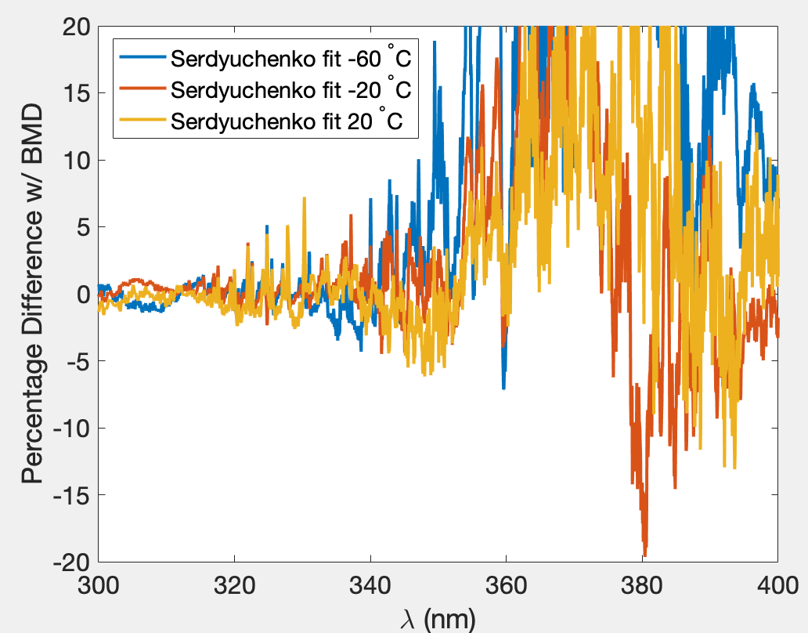
Cross section: Relative Difference wrt BMD

Slide 7
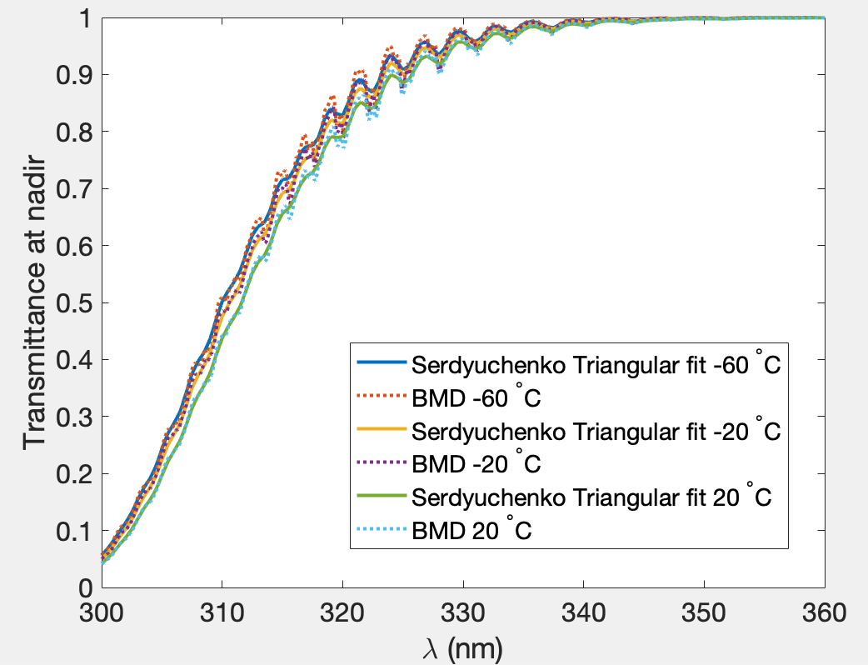
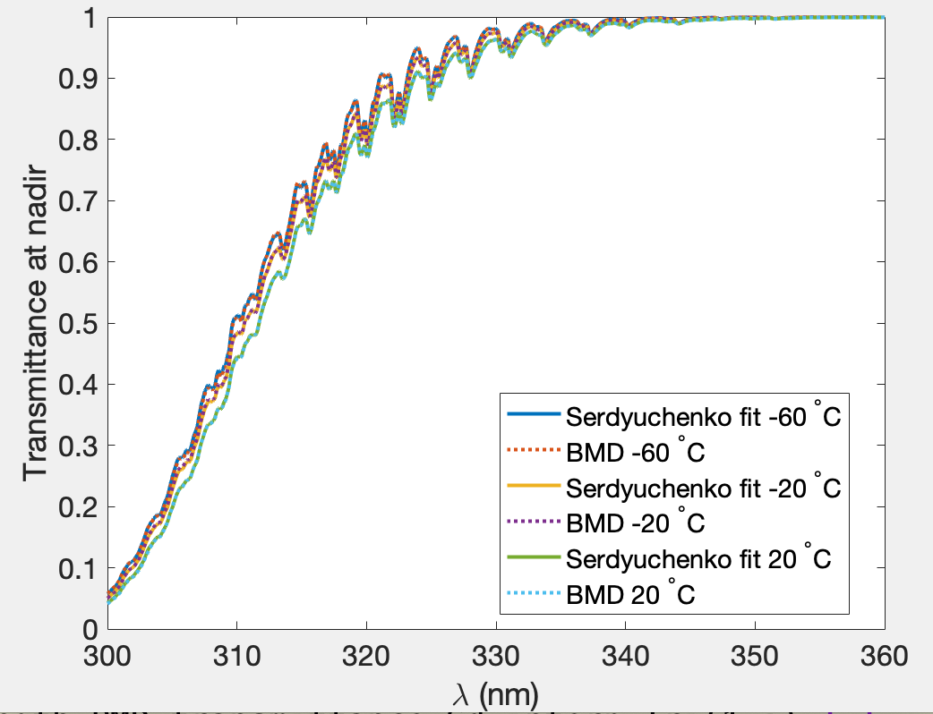
Transmittance $e^{−τ(λ)}$pattern in the UV
Column ozone: 300 Dobson unit.

Slide 8
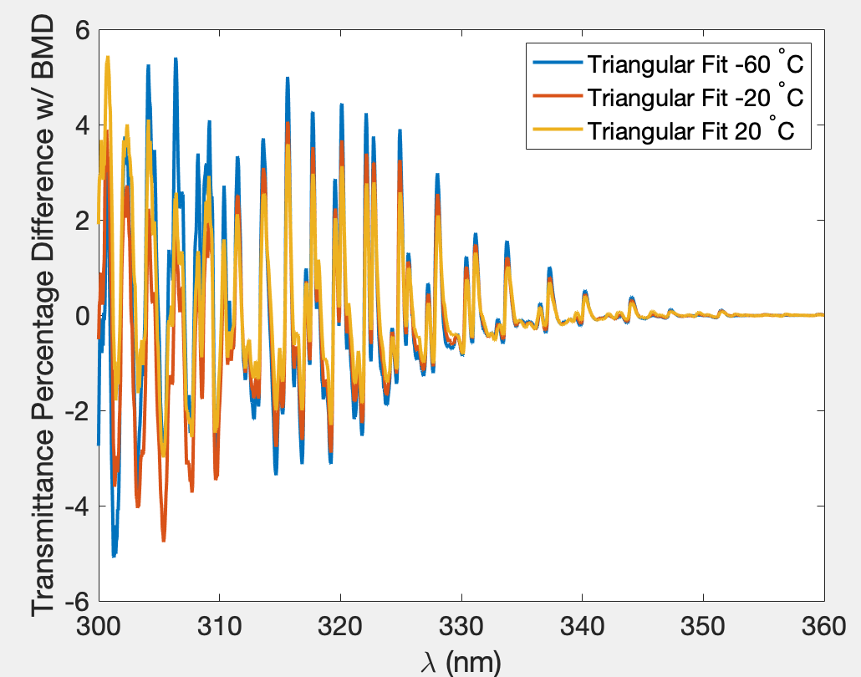
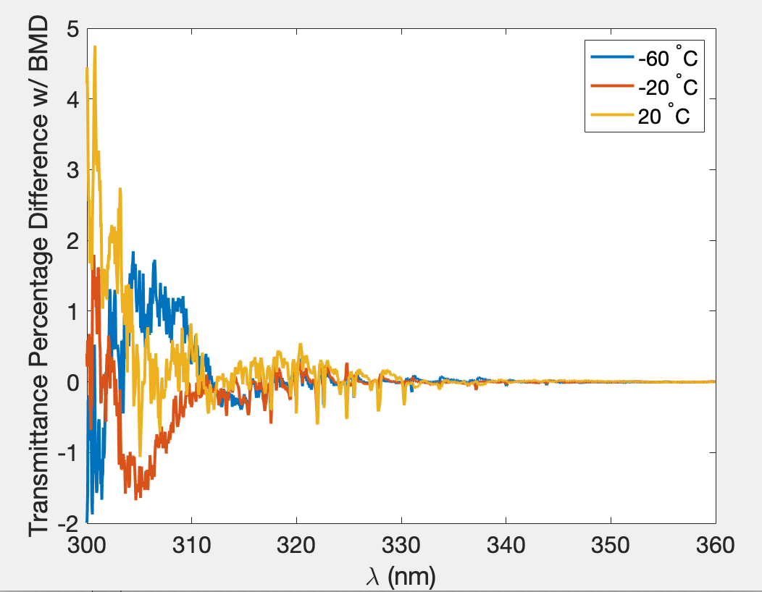
Transmittance difference wrt BMD

Slide 9
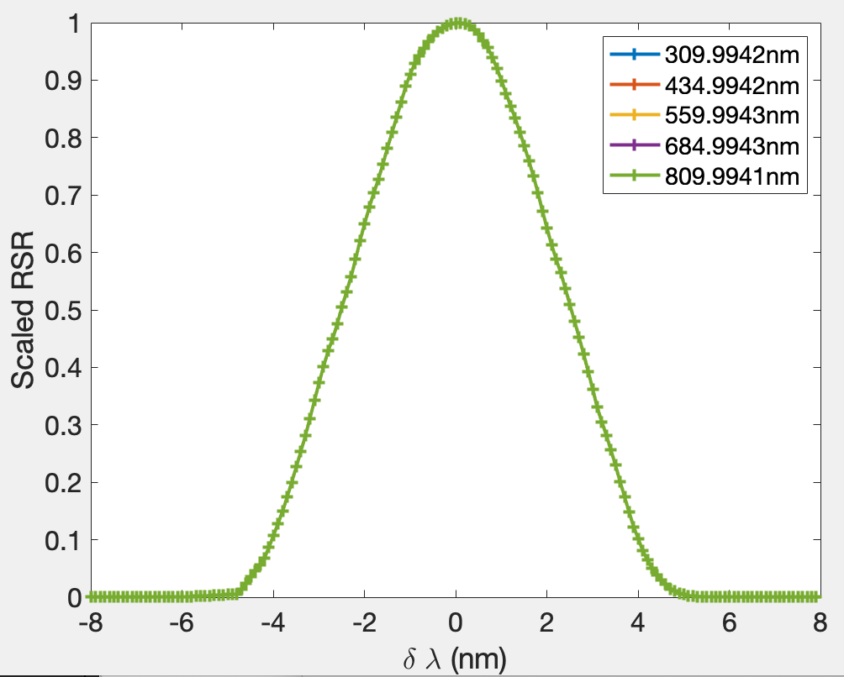
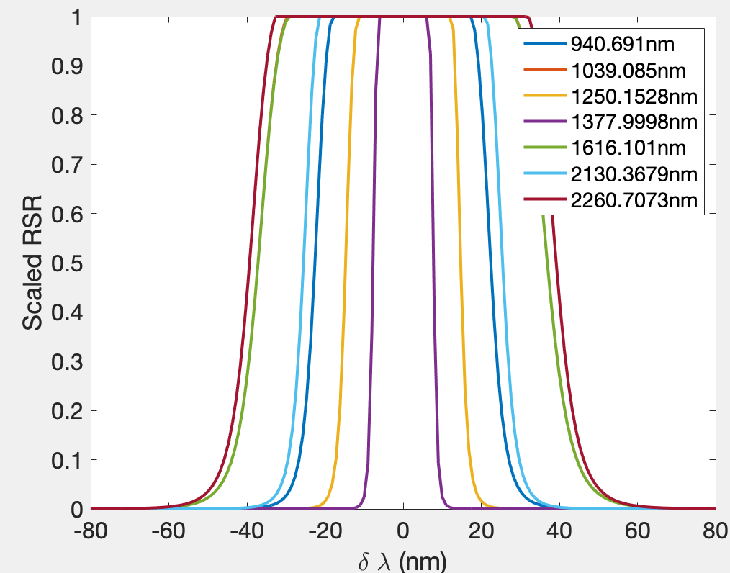
OCI Relative Spectral Response function

Slide 10
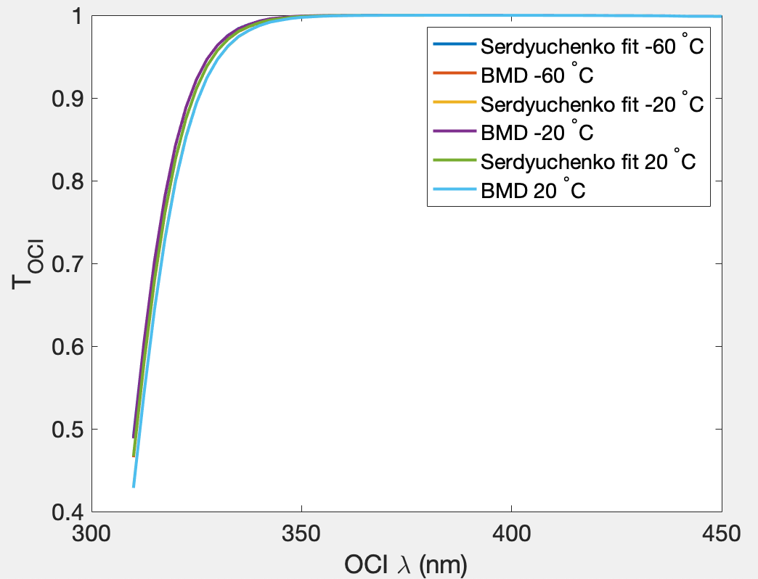
Transmittance convolved with OCI RSR
$T\left(λ\right)=e^{−τ(λ)}$
$T_{OCI}\left(λ\right)=\int_{−∞}^{∞}{T\left(λ^{′}\right)RSR\left(λ^{′},λ\right)dλ′}$
Column ozone: 300 Dobson unit.

Slide 11
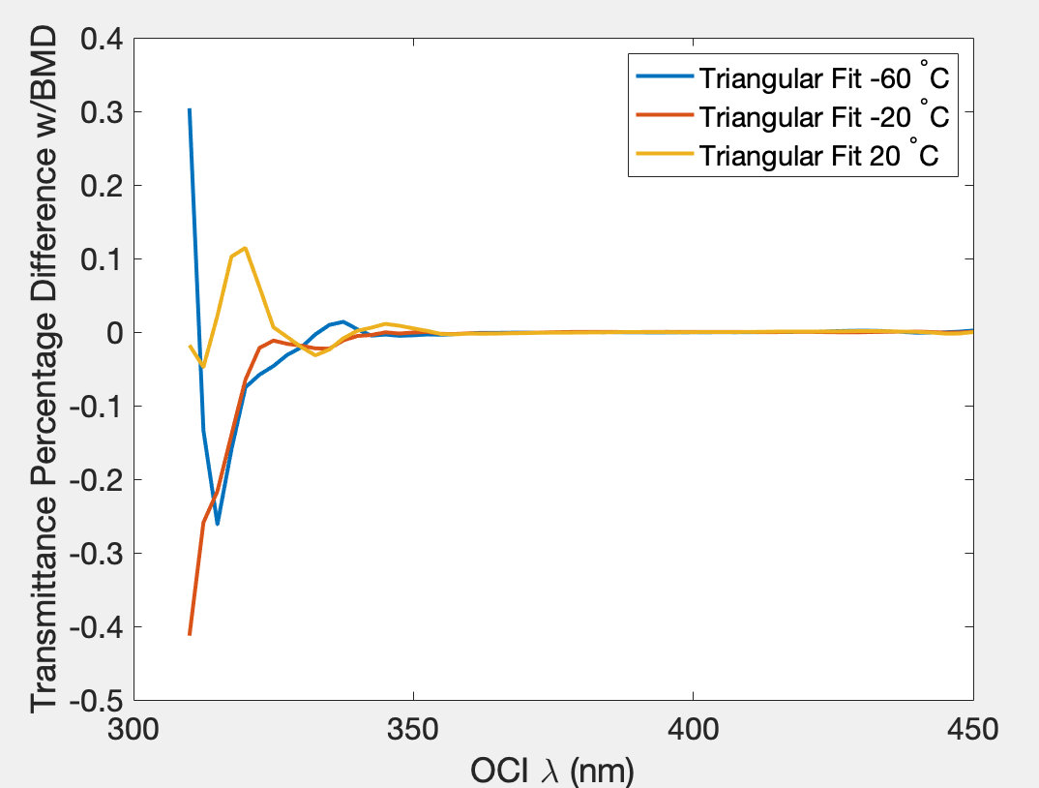
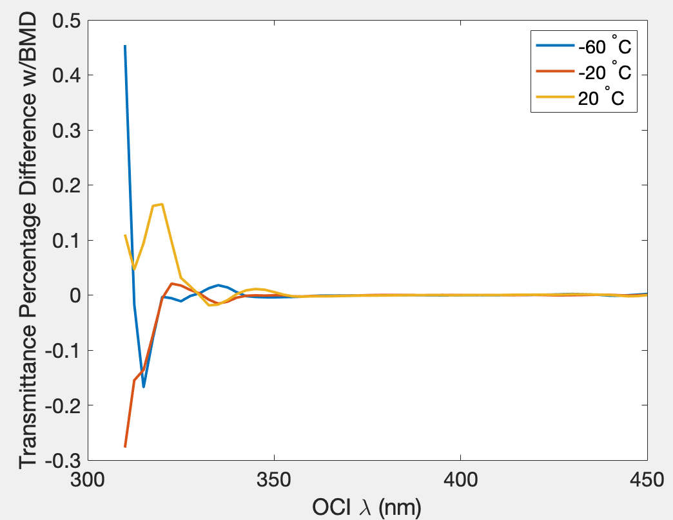
$T_{OCI}\left(λ\right)$ difference wrt BMD

Slide 12
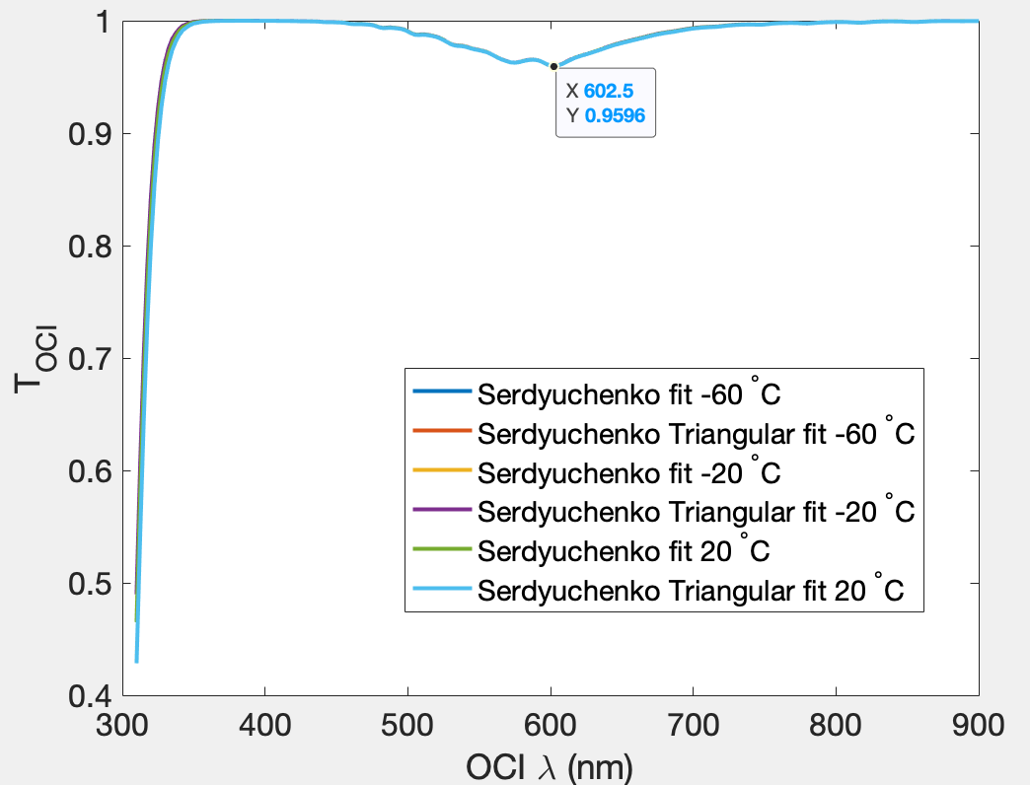
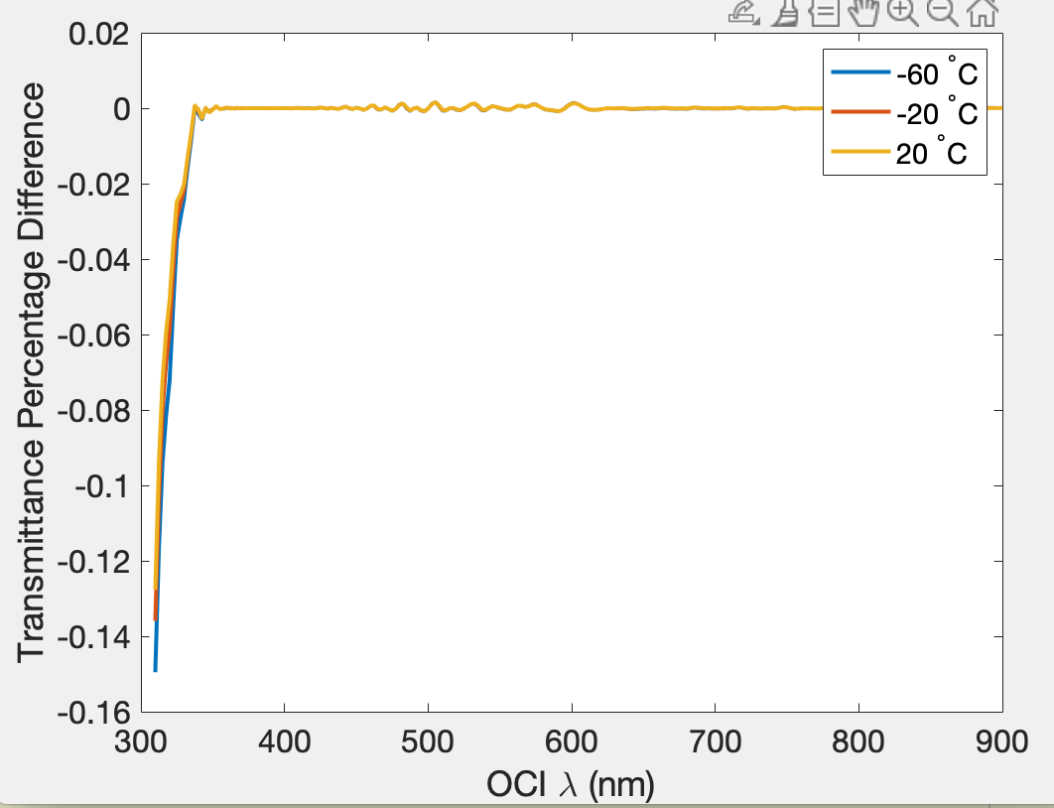
$T_{OCI}\left(λ\right)$ difference: Triangular and Raw fit
Column ozone: 300 Dobson unit.

Slide 13
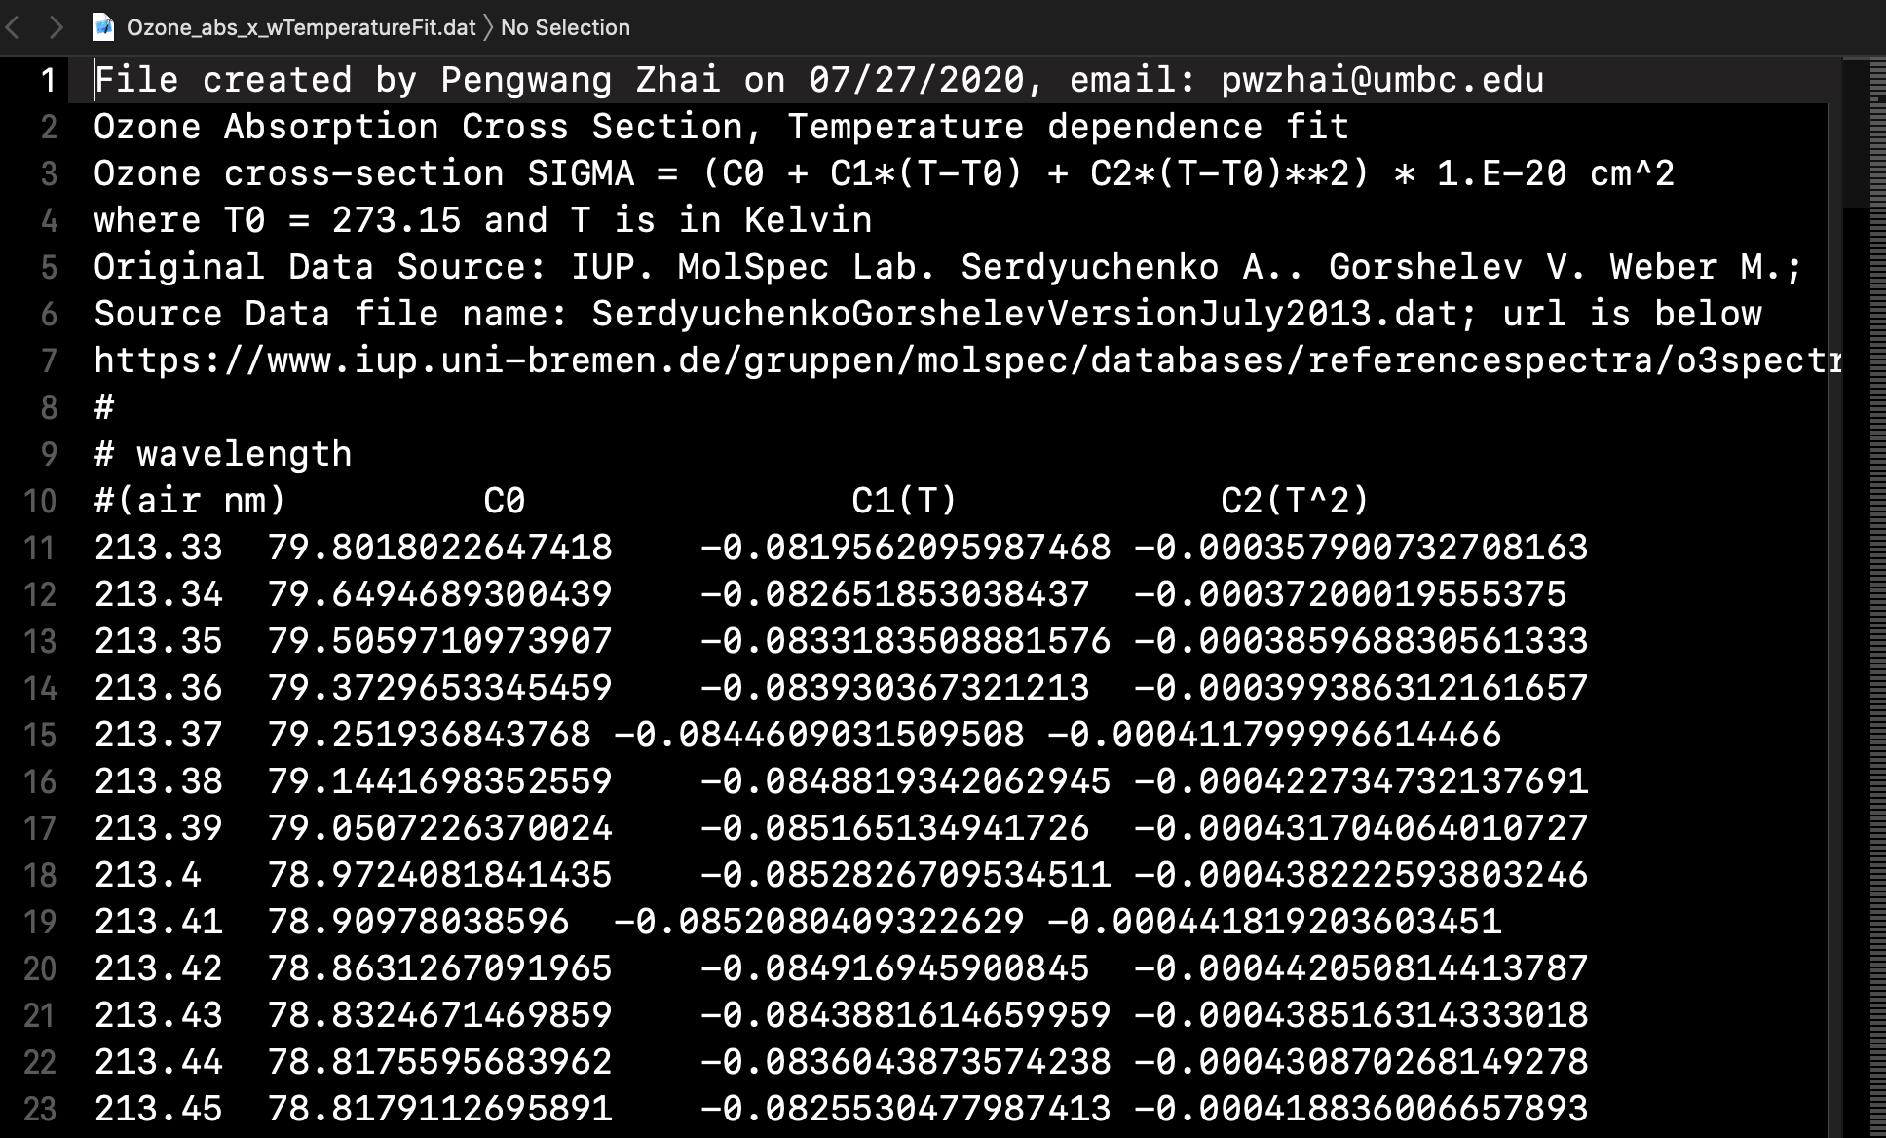

Slide 14
Summary
Temperature fitting of ozone absorption cross section measurements is performed based on the Serdyuchenko 2013 dataset.
Two schemes are tested: one with triangular filtering (Brian) and the other without (Pengwang).
Both schemes generate absorption cross sections with small differences wrt to BMD in the UV. The largest error appears in the lowest absorption bands (~380 nm).
A more meaningful error is in terms of transmittance, which is involved in the atmospheric correction process, which shows 5-6% of differences.
After the transmittance convolved with OCI RSR, the difference between triangular fitting and raw fitting results are only at the order of 0.15%.

